Slide 1
Security in Approximate Computing and Approximate Computing for Security: Challenges and Opportunities
By Weiqiang Liu , Chongyan Gu , Máire O’Neill, Gang Qu , Paolo Montuschi , And Fabrizio Lombardi

Slide 2
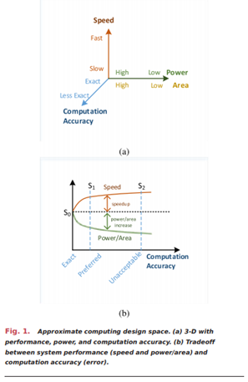
Technology Background
Approximate computing introduces security vulnerabilities
Existing work on the security of approximate computing covers threat models, countermeasures, and evaluations
Security threats of approximate computing from the perspective of…….
Hardware, namely, side-channel analysis (SCA), reverse engineering, cloning/counterfeiting, and active attacks
Cryptography, namely Homomorphic Encryption, Post-Quantum Algorithims, and Learning with Errors problems

Slide 3
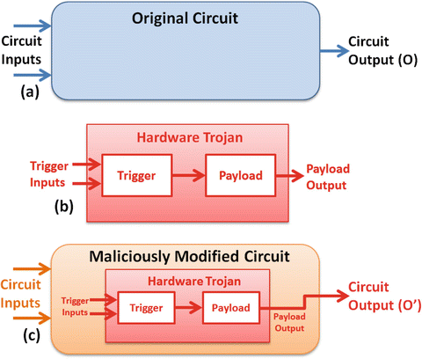
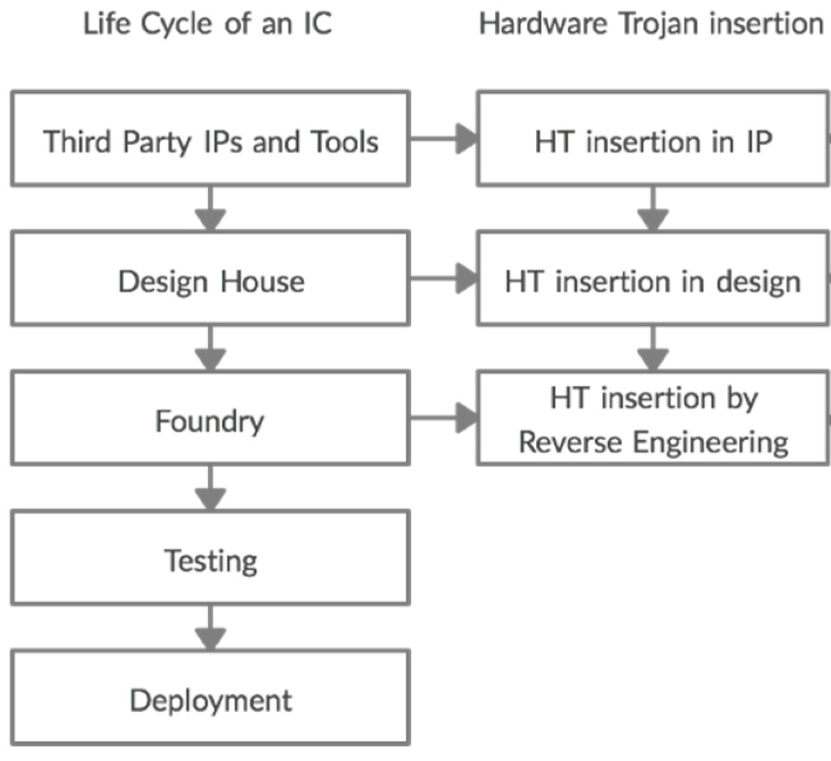
Intro to Hardware Security and Cryptography
Hardware Trojans
Any modification or addition to a circuit for malicious purpose
Logic Locking
Physical Unclonable Function
Side-Channel Analysis

Slide 4
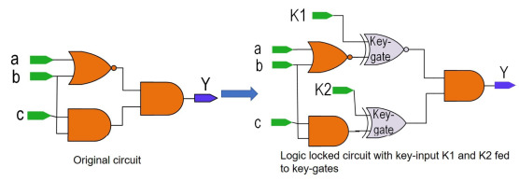
Intro to Hardware Security and Cryptography
Hardware Trojans
Logic Locking
Hiding important information, for example, functionality and implementation, related to a circuit by inserting additional logic into the original design.
Physical Unclonable Function
Side-Channel Analysis

Slide 5
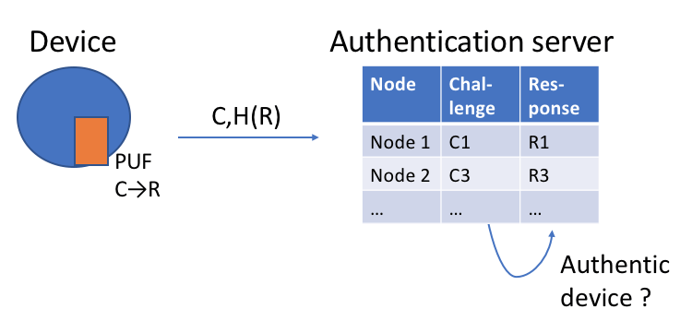
Intro to Hardware Security and Cryptography
Hardware Trojans
Logic Locking
Physical Unclonable Function
Utilizes the inherent process variations during manufacturing to generate a unique digital fingerprint that is intrinsic to the device itself.
Side-Channel Analysis

Slide 6
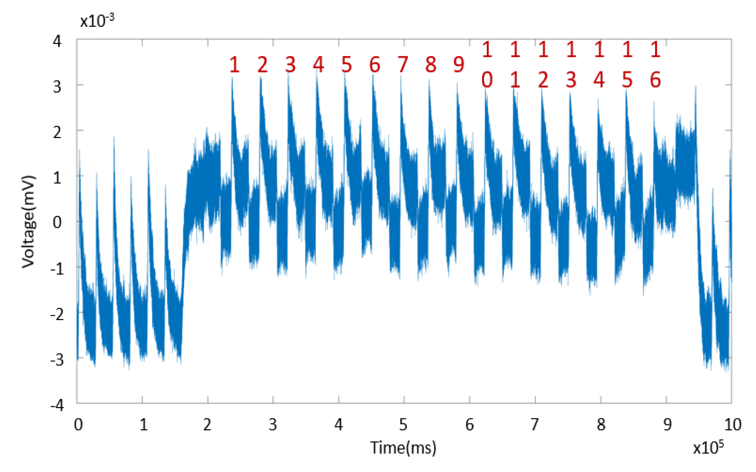
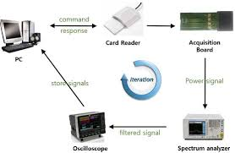
Intro to Hardware Security and Cryptography
Hardware Trojans
Logic Locking
Physical Unclonable Function
Side-Channel Analysis
Can reveal sensitive information from the implementation of security/cryptographic schemes by observing their electrical characteristics while operating

Slide 7
Intro to Hardware Security and Cryptography
Homomorphic Encryption
Cryptographic approach that can perform calculations directly on encrypted data without needing to decrypt the data first.
Post Quantum Cryptography (PQC)
Quantum computers may break today’s most popular public-key cryptographic systems, including RSA, elliptic-curve cryptography, DSA, and ECDSA.
Lattice Based Cryptography
Most popular branches of PQC due to its versatility, its security hardness, and the fact that it can be constructed efficiently on various computing platforms.

Slide 8
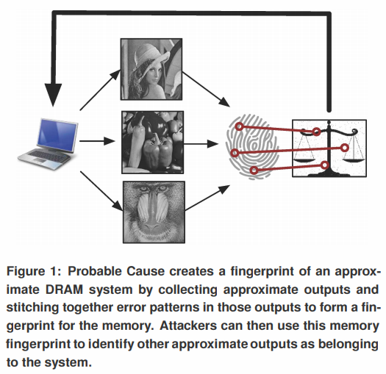
Security Threats in Approx. Computing
Organized by confirmed vs. potential security threats
Attacks
General -- Affects many applications
Voltage Scaling
DRAM
SRAM
Adders
PCM
Applications
Deanonymization, the only referenced DRAM term outside previous lectures
Image Processing
Pattern Recognition
Data Analysis

Slide 9
Security Threats in Approx. Computing:
Approximate Arithmetic Circuits
Malicious modification of registers
Force higher energy consumption through input manipulation
Hardware Trojans
Voltage scaling
Reverse Engineering
2
ECC
+
0
1
1
0
0
1
1
0
Inputs
Adder
Output
Simplified truncation logic

Slide 10
Security Threats in Approx. Computing:
Approximate Arithmetic Circuits
Malicious modification of registers
Force higher energy consumption through input manipulation
Hardware Trojans
Voltage scaling
Reverse Engineering
2
ECC
+
0
1
1
0
0
1
1
0
Inputs
Adder
Output
Simplified truncation logic
Effect: Increase power consumption through overworking ECC

Slide 11
Security Threats in Approx. Computing:
Approximate Arithmetic Circuits
Malicious modification of registers
Force higher energy consumption through input manipulation
Hardware Trojans
Voltage scaling
Reverse Engineering
6
ECC
+
0
1
1
0
0
1
1
0
Inputs
Adder
Output
Simplified truncation logic
Effect: Increase power consumption through overworking ECC
Effect: Decrease output quality without user specification, fools user

Slide 12
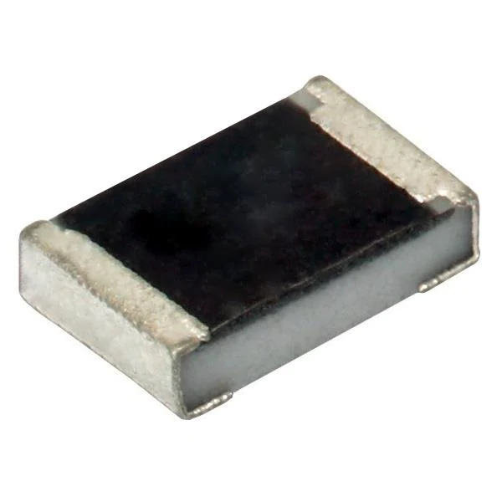
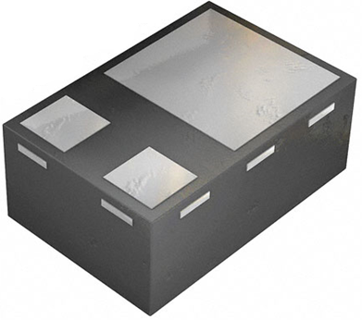
Security Threats in Approx. Computing: Approximate Arithmetic Circuits
Malicious modification of registers
Hardware Trojans:
Preying on control signals usually required by approximate logic
Preying on additional ECC module
Preying on more predictable transition probabilities
Voltage scaling
Reverse Engineering
Resistor
Transistor
Sample Hardware Trojan

Slide 13
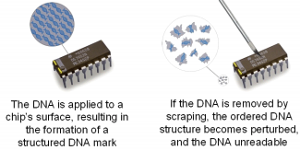
Security Threats in Approx. Computing: Approximate Arithmetic Circuits
Malicious modification of registers
Hardware Trojans
Voltage scaling: Create circuit anomalies by changing VDD
Increased propagation delay, change chip characteristics -> invalid PUF-like keys (physically-unclonable functions)
(Over-scaling to produce signal cross-talk)
Reverse Engineering
Sample process for creating a PUF – Uniquely identifies an arbitrary IC sample

Slide 14
Security Threats in Approx. Computing: Approximate Arithmetic Circuits
Malicious modification of registers
Hardware Trojans
Voltage scaling
Reverse Engineering: Attackers reconstructing a circuit design from a physical copy
Increased obfuscation from additional control logic
RE’d circuit will be approximate, not precise logic
Sample process for creating a PUF – Uniquely identifies an arbitrary IC sample

Slide 15
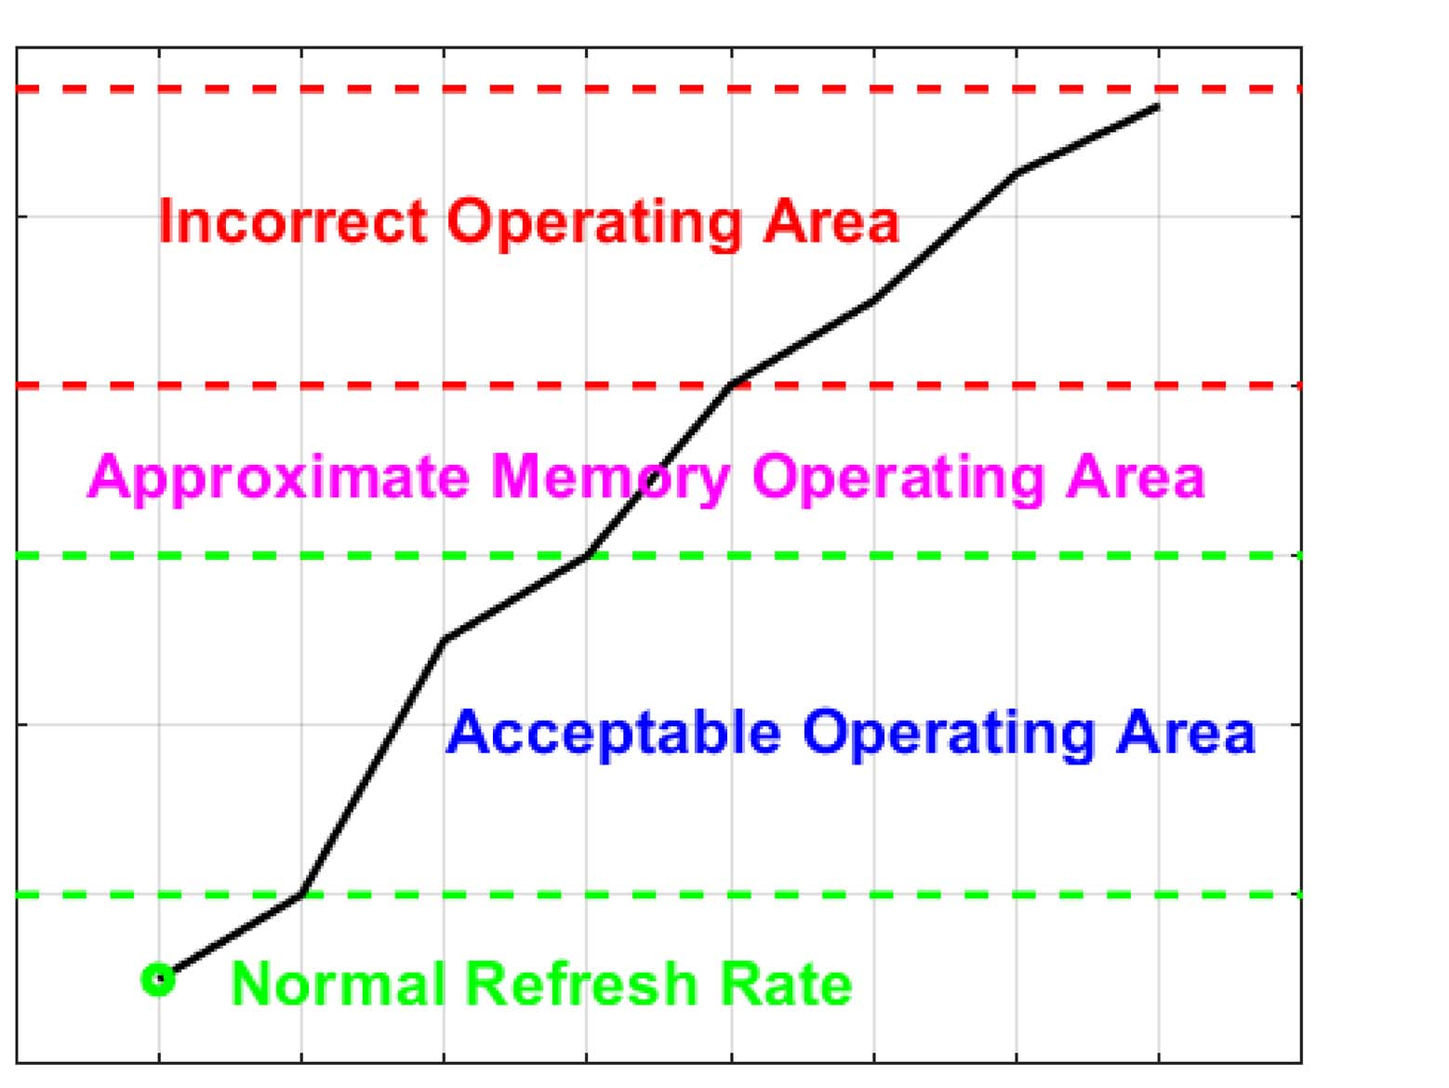
Security Threats in Approx. Computing: Approximate Storage
DRAM approximation:
Refresh rate can only fall so much before errors are unrecoverable
Attackers can force this threshold to be met via register manipulation of A) DRAM refresh counter or B) configuration signal
SRAM Approximation
PCM Approximation
10
0
User-configured refresh rate
Refresh signal
DRAM block

Slide 16
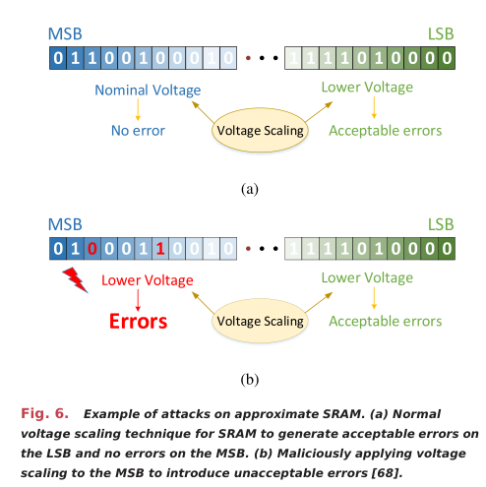
Security Threats in Approx. Computing: Approximate Storage
DRAM approximation
SRAM Approximation
Register manipulation applies voltage scaling to MSBs and LSBs instead of just LSBs
PCM Approximation

Slide 17
Security Threats in Approx. Computing: Approximate Storage
DRAM approximation
SRAM Approximation
PCM Approximation
Many manipulatable signals to A) Obliterate approximate information or B) Approximate what should have been precise
0
Voltage scaling constant
1V
x
Variable scaling ratio
0.1
0
V_{dd}
Select = Should approximate?

Slide 18
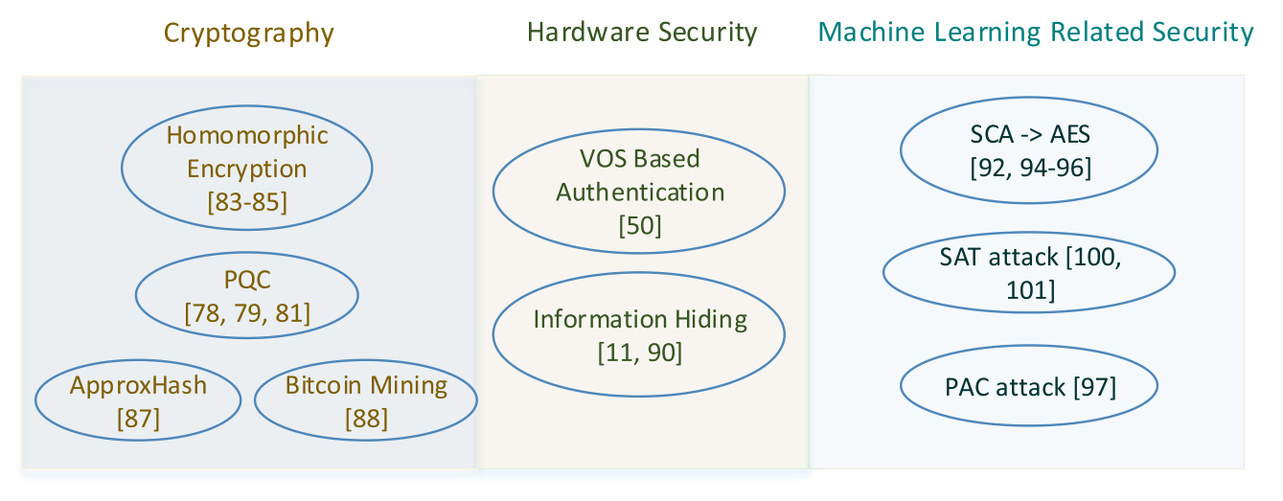
Approx. Computing for Security
Applies in two(?) main topic areas + machine learning

Slide 19
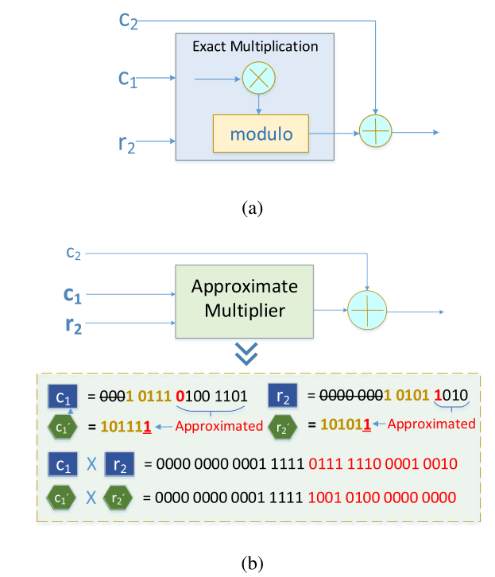
Approx. Computing for Security: Cryptography
Postquantum cryptography:
Approximate random sampler
Approximate multiplier
Allows 35% less circuit area, 23% power reduction, minimal decrease in output entropy
Homomorphic Encryption:
Makes significant use of modular arithmetic
Approx . Hardware to simulate ring learning with errors (RLWE) for linear instead of exponential time complexity (!!!)
ApproxHash:
Replace adders with approx. adders for approx. SHA-1
Less relevant to modern security since SHA-1 is deprecated
Bitcoin Mining:
Operational costs ∝ energy consumption
Approx. arithmetic using less energy = more efficient mining

Slide 20
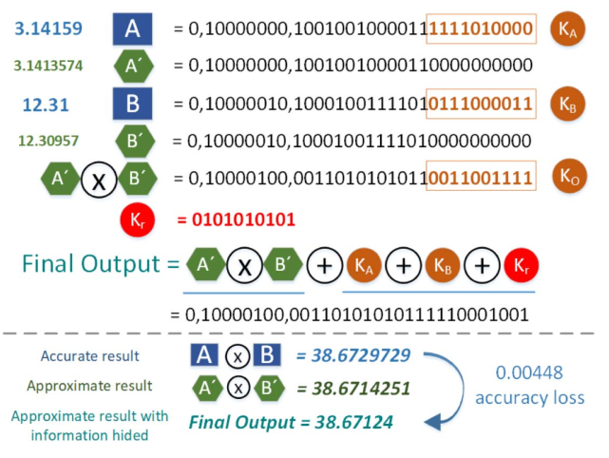
Approx. Computing for Security: Hardware Security
Information Hiding for Approximate Computing
Steganography using approximate operators
VOS-Based Authentication

Slide 21
Approx. Computing for Security: Hardware Security
Information Hiding for Approximate Computing
VOS-Based Authentication
Unmasks process variation for soft device authentication
Can be used for lightweight IoT fingerprinting

Slide 22
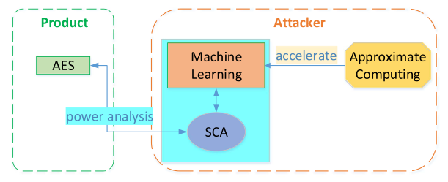
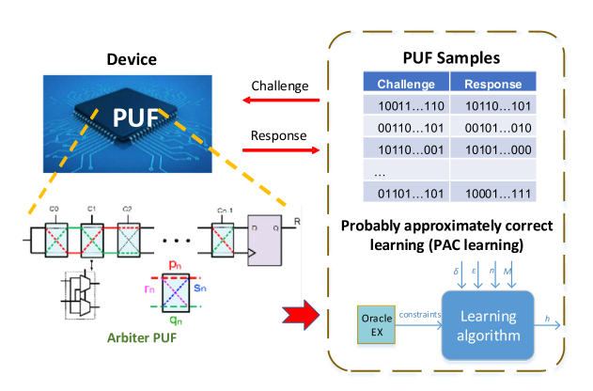
Approx. Computing for ML-Based Security [Violations]
Side-Channel Analysis (SCA) of Cryptographic Algorithms
SVM and Random-Forest networks to analyze side channel data
PUF
ML-based methods for determining PUF signatures can be greatly accelerated through approx. computing
Logic Obfuscation

Slide 23
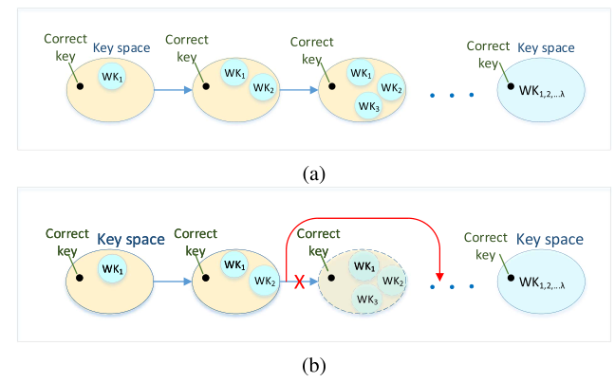
Approx. Computing for ML-Based Security [Violations]
Side-Channel Analysis (SCA) of Cryptographic Algorithms
PUF
Logic Obfuscation/Locking: Focus on Boolean Satisfiability (SAT) attack
Typical approaches involve finding all wrong keys through trial and error – last remaining key must be correct
Proposes finding general groups of wrong keys for much smaller time complexity
Concept of logic locking – True functionality is obscured without key

Slide 24
Future Research
Error Manipulation
Characterizing the errors generated by approximate designs could be helpful in identifying malicious errors inserted by an adversary.
For example, a threshold value could be used for errors of approximate designs. Any error that goes beyond the threshold will be considered as a potential malicious attack.

Slide 25
Future Research
Testing
In addition to the objectives for normal testing, testing techniques for approximate computing need to consider whether the approximate mechanism is deterministic or nondeterministic and whether it is static or dynamic.
Hardware Trojans
Countermeasures to Attacks on Approximate Computing

Slide 26
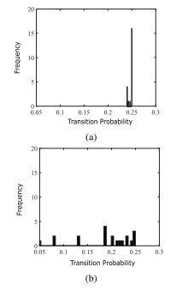
Future Research
Testing
Hardware Trojans
Approximate computing could change the transition probability of certain signals dramatically. Such change could make the trigger signal of an HT easier to be detected, and it could also introduce rare signal values that can be used as the trigger.
Countermeasures to Attacks on Approximate Computing

Slide 27
Future Research
Testing
Hardware Trojans
Countermeasures to Attacks on Approximate Computing
Most of the existing works on the vulnerability of and attacks to approximate computing have countermeasures as well
However, their main contribution is on the discovery of new vulnerabilities and attacks.
Countermeasures are normally simple and straightforward.

Slide 28
Future Research
Security in Cross-Layer Approx Comp.
In the future, it will be necessary to perform cross-layer security analysis for approximate computing.
Security of Approx Mem.
Emerging nonvolatile memory technologies, such as resistive random access memory (RRAM) and magnetic random access memory (MRAM), have become attractive for future memory hierarchies.

Slide 29
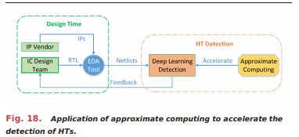
Future Research
Approximate PUF
It is worth investigating the feasibility of building approximate processor-based intrinsic PUFs for the specific system- or architecture-level applications.
Hardeware Trojan Detection
Recently, machine learning-based approaches, such as NNs, have been proposed for HT detection.

Slide 30
Conclusion
Core challenges in approximate computing is how to balance security, performance, and errors
Research on security-related challenges and opportunities for approximate computing has been neglected to some extent
Currently, security in/for approximate computing has not been widely studied. In particular, the utilization of approximate computing to enhance security/cryptographic primitives has a promising future.

Slide 31
Question 1
What are the two classifications for Physically Unclonable Functions (PUF's)
Big PUF, Small PUF
Strong PUF, Weak PUF
Linear PUF, Evolutionary PUF
Approximate PUF, Conevtional PUF

Slide 32
Question 2
What are two reasons approximate circuits are more susceptible to Trojan insertion?
Approximate logic usually is accompanied by additional control logic, which can be hijacked
Approximate logic can yield more predictable logic transitions, which makes triggering Trojans easier
Since fewer researchers are in the approximate computing domain, fewer countermeasures are developed for Trojans in this area
Approximate logic must be decoupled from most other on-chip logic, so it is easier to target

Slide 33
Question 3
What module is responsible for increased power consumption during attacks on approximate hardware as specified in “Security in Approximate Computing and Approximate Computing for Security”?
Approximate control signals
User-configured startup parameters
ECC (Error correction code) logic
Coupling logic between approximate and precise circuitry

Slide 34
Question 4
What are 2 ways Approximate Computing may be susceptible to securty breaches?
Error Manipulation
Voltage Encryption
Voltage Modification
Approximate-Memory Analysis

